Slide 1
Climate Change Solutions Group
UBC - The First Canadian University to have a Sustainability Plan

Slide 2
Buildings 2010 – 2015 30% Reduced GHGs
majority of UBC’s emissions come from buildings
success to date has been achieved by:
1. Converting Academic District Energy System (ADES) from steam to hot water
24% increase in overall energy efficiency
proportional savings in operations and reductions in GHGs;
2. Establishing Bioenergy Research and Demonstration Facility (BRDF) provides renewable heat and power to the ADES;
3. Implementing Building Tune-Up Program
improve energy and emissions performance in existing buildings

Slide 3
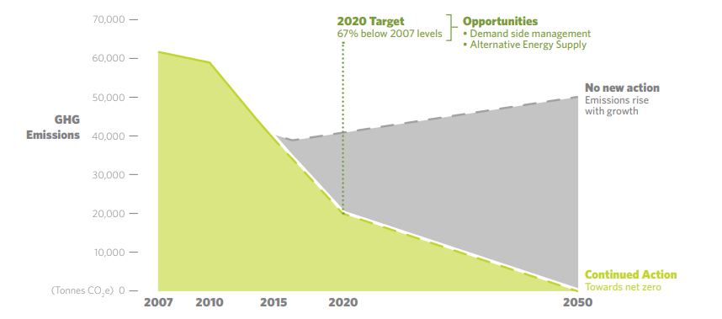
Plan 2016 - 2020

Slide 4
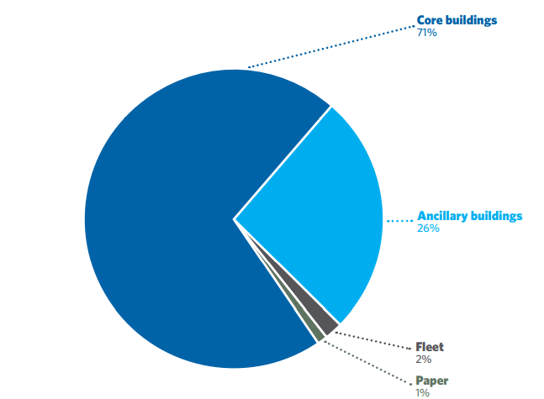
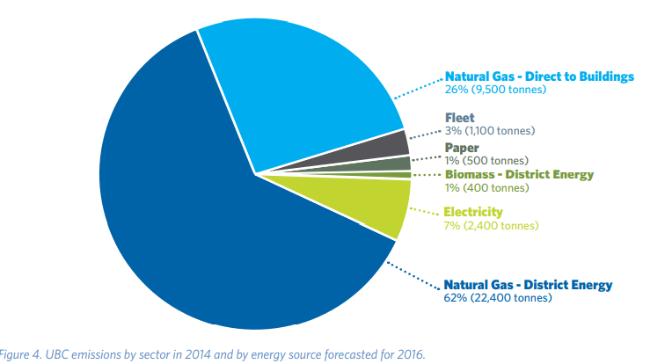
GHG Energy & Emissions sources

Slide 5
Existing Buildings – Tune Up Program
Use Wi-Fi occupancy data to help with building occupancy and optimize building energy performance
Auditing building systems where appropriate, including sensors, lighting and mechanical insulation
Integration of audits and analysis outputs into project planning
Reduce thermal demand through use of high-efficiency mechanical equipment
In renovation projects, use equipment choices that impact sustainability performance (particularly energy and water consumption), especially in UBC’s 400 labs
Use “expert” software systems including automated fault detection systems to manage operations and maintenance for energy efficiency

Slide 6
New Buildings
Support building design teams in Net Positive building design
Net Positive buildings that do not require energy input, and do not produce any net emissions
Stronger focus on life cycle costs
Organize student design competitions for energy efficient UBC buildings - contributing innovative design aspects and research
To date UBC’s energy conservation program has resulted in an annual savings of 28,400 tons in GHGs, equivalent to taking 6,200 cars off the road for a year

Slide 7
Food On Campus (except franchises)
60% of UBC Food Services ingredients purchased from local producers (within 400km of UBC)
Sustainable Seafood
All seafood is 100% Ocean Wise certified
Fair Trade
Fairtrade certified products, including all our coffees and teas, available at all UBC Food Service Locations
Food Recovery
Partner with local organizations to deliver food, that’s still safe but can't be sold, to local community groups

Slide 8
Food on Campus
Goal is to divert 80 % of our operational garbage from the landfill by 2020
Have a ‘closed-loop’ system for food scraps collected: we turn food and plant waste into compost used for gardening on campus By keeping plastic out of food scraps stream, we turn the 5 tonnes of organic waste UBC produces daily into a clean compost
In res dining rooms, save 20¢ when you use Green2Go containers. When you use a disposable container you add it to the waste stream and it will cost you 75¢. Save a disposable container from the waste stream and become a UBC Zero Waste hero.
160,000 disposable containers enter the waste stream at UBC each year. That’s worth over $85,000!
BYOC – beverage prices down by 25 cents but no cup, you pay 25 cents

Slide 9
Roots on the Roof
A 100% student-run club that manages the rooftop garden space and community garden plots on roof of AMS Student Nest
To grow and harvest food sustainably
Develop and conduct food literacy workshops around food, culture, health, and sustainability
To create an inclusive space for social engagement and opportunities to explore, learn, and actively take part in food system initiatives.

Slide 10
Orchard Garden Community by Faculty of Land and Food Systems
By sheet mulching with cardboard, then with wood chips, able to prevent weeds from emerging through the cardboard ('sheet') barrier all season
Use cardboard because it's biodegradable, easily accessible and costs nothing
The wood chip covering decomposes and adds nutrients and organic matter to the soil food web, while also slowing the emergence of weeds in the long term
It's nicer to look at than cardboard and holds it in place

Slide 11
UNA Community Gardens
The University Neighbourhoods Association (UNA) has three vibrant community gardens available for residents
They are extremely popular and provide an opportunity for residents to grow food and flowers, as well as to connect with each other

